Slide 1
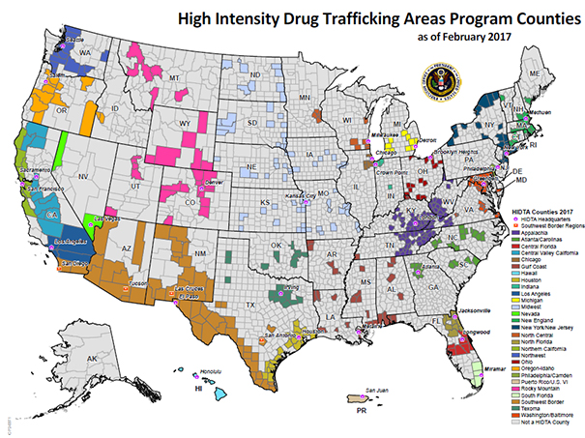
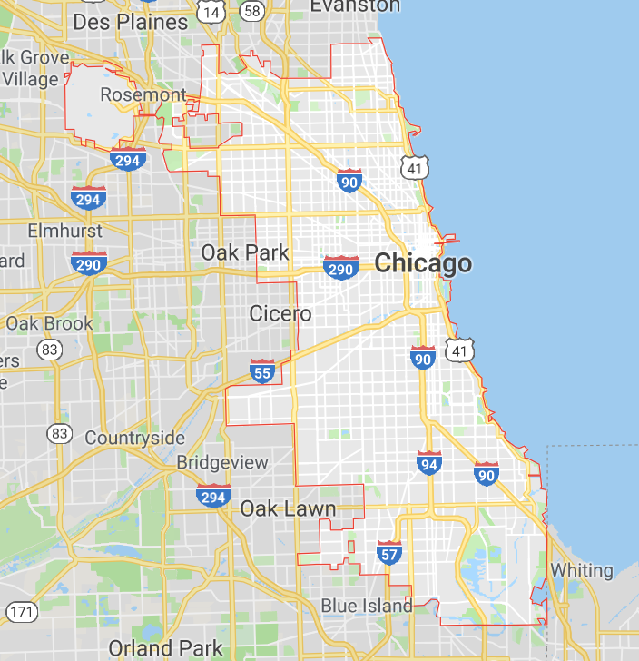
Spatiotemporal patterns of drug activities in U.S. cities
Luna Zhiyue Xia
Chicago
https://www.dea.gov/hidta

Slide 2
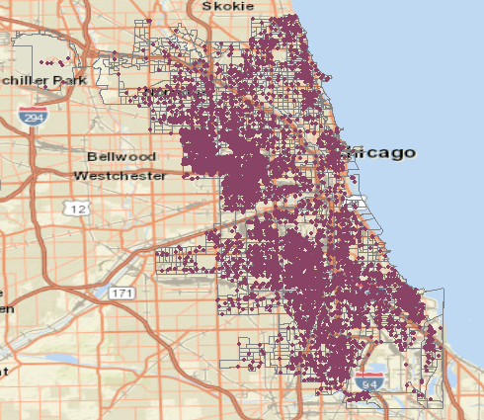
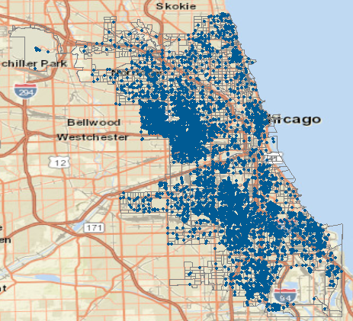
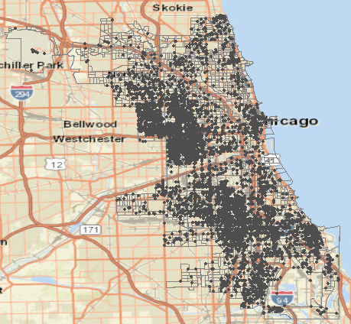
Background and some accomplished works
Drug arrests in Chicago for 2016, 2017, and 2018
Lake Michigan
Lake Michigan
Lake Michigan
2016
2017
2018
37546 drug-related arrests from 2016 – 2018
Year Drug type | 2016 | 2017 | 2018
Total drug arrest | 13261 | 11486 | 12799
Data sources:
Drug arrest data from Chicago Data Portal

Slide 3
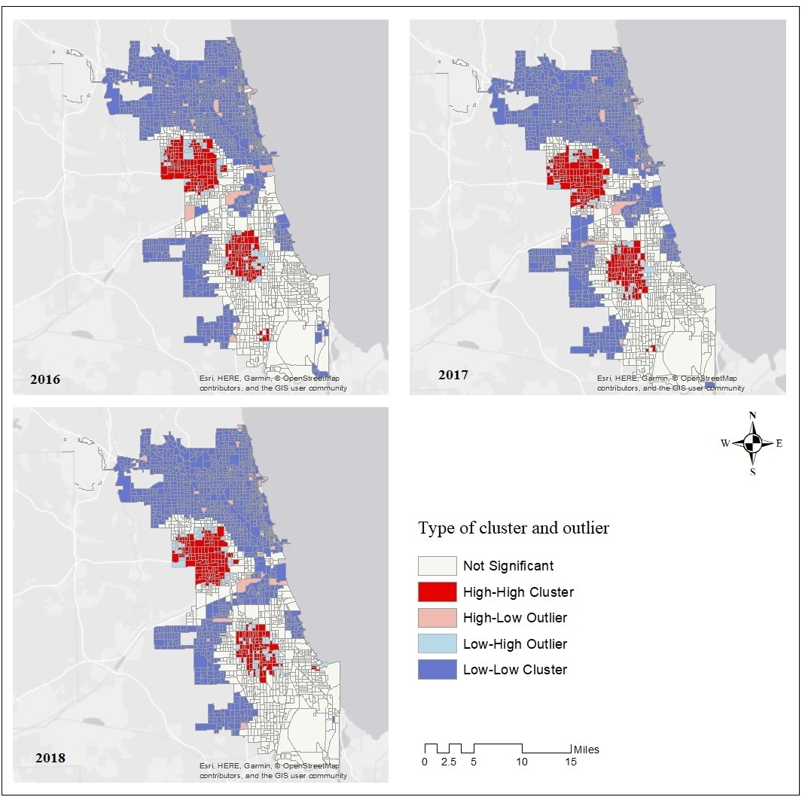
Hotspots of drug arrests in Chicago for 2016, 2017 and 2018
Background and some accomplished works
Moran’s I spatial clustering
Two major hotspot locations for arrests are revealed in the city
Based on all drug-related arrests

Slide 4
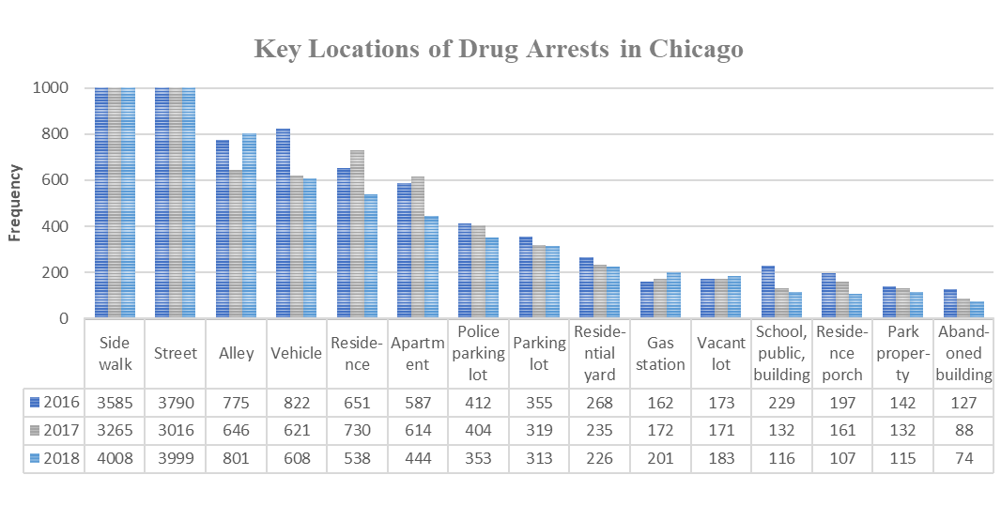
Drug arrest location analysis
Most frequent drug arrest locations (2016, 2017 and 2018) in Chicago
5 key locations: alleys, parking lots, vacant lots, abandoned buildings, and gas stations.

Slide 5
Background and some accomplished works
Selected variables of analysis
 | Variables | Descriptive variables
Economic | Income | Median household income, Number of household with income below poverty level...
Demographic | Employment | Total employment, Full time employment, Percent of population that is working aged…
 | Education | Population of Bachelor’s degree or higher…
 | Race | White population, black population, Asian population, Hispanic or Latino population…
Built environment | Drug activity key location | Vacant building, vacant lot, gas station, alley, parking lot
 | Urban design | Road network density, Street intersection density…
Transit | Transit distance | Distance from population weighted centroid to neatest transit stop, Proportion of employment within ¼ mile to transit stop….
 | Access to workers | Jobs within 45 minutes auto travel time, Working age population within 45 minutes auto travel time…
Data sources:
EPA Smart Location and U.S. Census 2016 ACS 5-year estimate
Data sources of key locations:
Gas Stations: ESRI Business Analyst Server
Vacant Building and Vacant Lots: Chicago Data Portal
Alley: WBEZ , Chicago Parking Lots: Open Street Map

Slide 6
Hypotheses:
The spatial patterns of drug activities in city areas are significantly clustered
Drug arrests (which record times and locations) can be used as a proxy of drug activities
The spatial patterns of drug activities are correlated with built environment, demographic and socioeconomic.

Slide 7
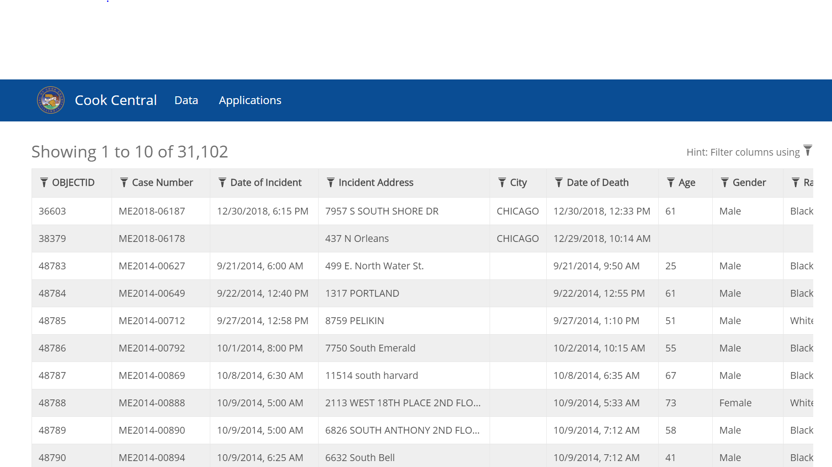


Hypotheses 2:
Drug arrests (which record times and locations) can used as a proxy of drug activities
Examine spatial patterns of drug arrests, overdoes related death and drug related emergency medical service (EMS)
Analyze drug activities from three aspects, possession and delivering (drug arrest), related death (Medical Examiner Case Archive) and medical service (EMS).
https://hub-cookcountyil.opendata.arcgis.com/datasets/4f7cc9f13542463c89b2055afd4a6dc1_0/data

Slide 8
Framework of final project
Drug possession and trafficking:
Reported narcotic incidents
Spatial and temporal patterns
Are the patterns of drug crime, death and medical service the same?
What built environment and sociodemographic factors are correlated with these spatiotemporal patterns?
Drug related death:
Medical Examiner Case Archive
Spatial and temporal patterns
Packages will be used:
Access data: sodapy (a python client for the Socrata Open Data API)
osmnx
cenpy
Data analysis: numpy
pandas
geopandas
PySAL
scikit-learn
……
EMS for drug overdose:
Fire Department EMS records
Spatial and temporal patterns

